Slide 1
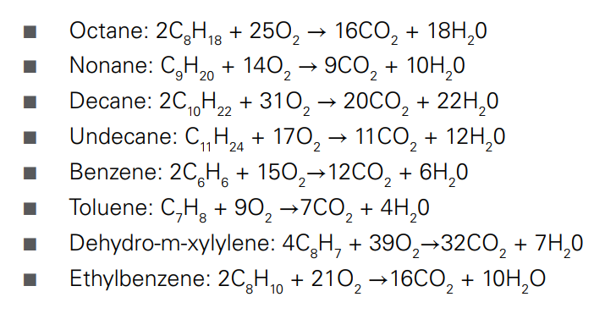
The Science Behind Exhaust Emissions Testing
For an engine to work properly, the right ratio of oxygen and gasoline needs to mix to optimize for combustion. The reactions for each are as follows:

Slide 2
Pollutants and How They Affect the Environment
Particulate matter
Particulate matter is a particle or droplet that is 10 micrometres or smaller. This is the specified size
Because that is the maximum size that can be absorbed by human lungs. Usually, diesel engines are the biggest culprit of producing particulate matter like ash, sulphates, diesel soot, and metallic abrasion particles.
These can result from any different number of factors, but all are considered carcinogens.

Slide 3
Nox
Traditionally, oxygen and nitrogen do not react at ambient temperatures.
However, when heated to high temperatures, ‎N₂ and O₂ can dissociate. After dissociation, they have the potential to react with each other, potentially undergoing an endothermic reaction to create NOx (NO or ‎NO₂).
NOx, if distributed into the atmosphere, eventually forms nitric acid, which is a heavy contributor to acid rain.

Slide 4
Hydrocarbons
Many hydrocarbons have been classified as carcinogens, which is why their emissions are regulated and closely monitored in new engine designs.
Hydrocarbons themselves can be better defined as unburned fuel. If some portion of the petrol does not combust (react with the oxygen) when the spark ignites the fuel in the cylinder, it passes out through the exhaust unburned.
If the ignition is improperly timed and is ignited before or after the desired angle from top dead centre, the reaction will not occur stoichiometrically. Also, non-stoichiometric fuel mixture or a defective catalytic converter can result in high hydrocarbon content

Slide 5
CO
Much like hydrocarbons, incomplete combustion can result in carbon monoxide (CO) production.
A low air/fuel ratio means there is less air than needed for a full reaction and results in the creation of CO, which in large quantities is toxic to humans and animals.

Slide 6
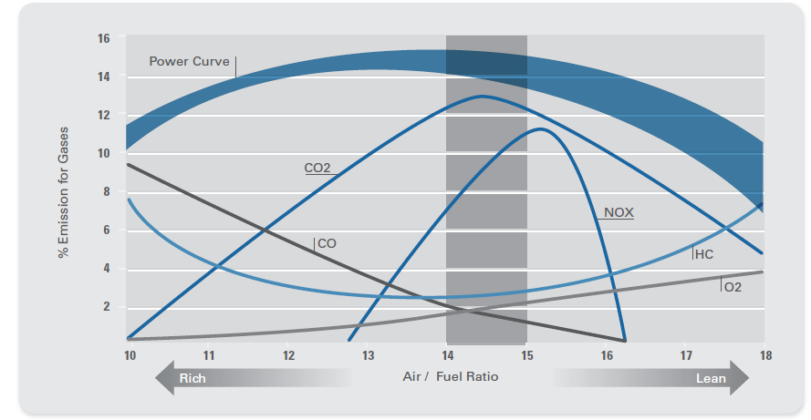
The Effect of Air/Fuel Mixture on Exhaust Emissions

Slide 7
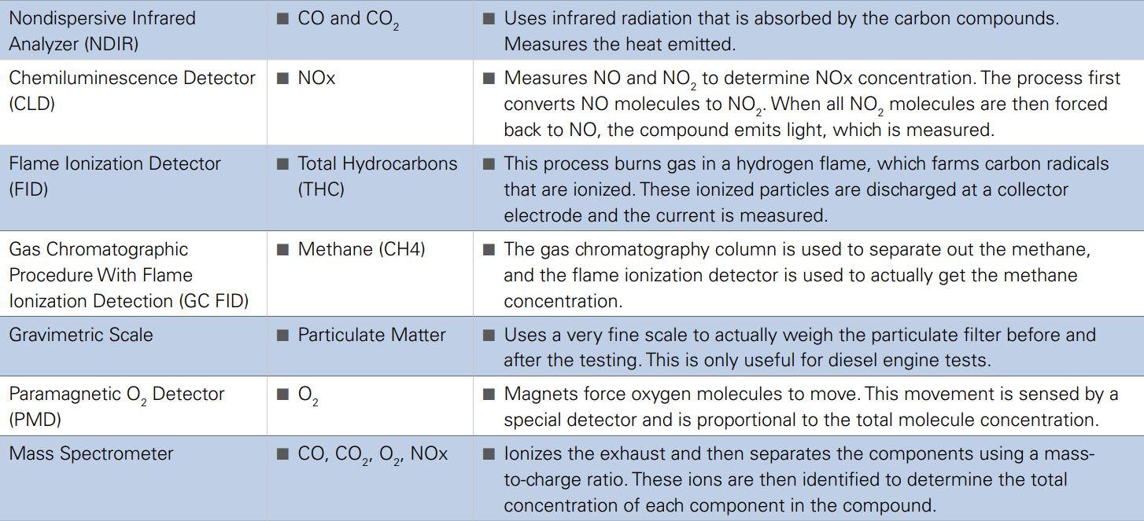
Techniques used to measure various components in exhaust gas

Slide 8
nondispersive infrared analyzer (NDIR)

Slide 9
A nondispersive infrared analyzer (or NDIR sensor) is a simple spectroscopic analyzer often used as a gas detector.
The majority of NDIR analyzer use a broadband lamp source and an optical filter to select a narrow band spectral region that overlaps with the absorption region of the gas of interest.
Compound measured : CO and CO2
Sensing wavelengths :
CO₂ - 4.26 μm, 2.7 μm, about 13 μm
Carbon monoxide - 4.67 μm, 1.55 μm, 2.33 μm, 4.6 μm, 4.8 μm, 5.9 μm

Slide 10
PRINCIPLE
The main components of an NRID sensor are an infrared (IR) source (lamp), a sample chamber and an infrared detector.
The IR light is directed through the sample chamber towards the detector. In parallel there is another chamber with an enclosed reference gas, typically nitrogen.
The gas in the sample chamber causes absorption of specific wavelengths according to the beer–lambert law, and the attenuation of these wavelengths is measured by the detector to determine the gas concentration.
The detector has an optical filter in front of it that eliminates all light except the wavelength that the selected gas molecules can absorb.
Ideally other gas molecules do not absorb light at this wavelength, and do not affect the amount of light reaching the detector
The IR signal from the source is usually chopped or modulated so that thermal background signals can be offset from the desired signal.

Slide 11
WORKING
Non-dispersive infra-red (NDIR) detectors are the industry standard method of measuring the concentration of carbon oxides (CO & CO₂).
Each constituent gas in a sample will absorb some infra red at a particular frequency. By shining an infra-red beam through a sample cell (containing CO or CO₂), and measuring the amount of infra-red absorbed by the sample at the necessary wavelength, a NDIR detector is able to measure the volumetric concentration of CO or CO₂ in the sample.
A chopper wheel mounted in front of the detector continually corrects the offset and gain of the analyzer, and allows a single sampling head to measure the concentrations of two different gases.
The combustion fast NDIR uses a unique sampling system, coupled to miniaturized NDIR technology to give millisecond response times.
The combustion fast NDIR has two remote sampling heads controlled by a main control unit, and is capable of sampling co & co₂ simultaneously in two locations.

Slide 12
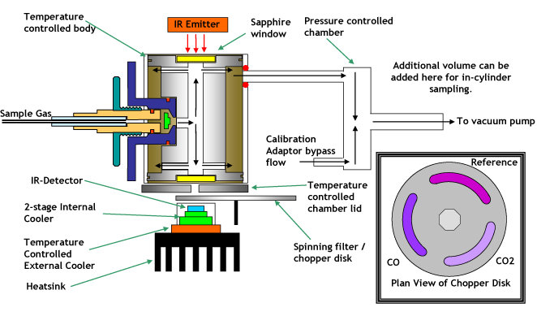
LAYOUT

Slide 13
CHEMILUMINESCENCE DETECTOR (CLD)

Slide 14
Chemiluminescence is the emission of light by molecules, induced by a chemical reaction.
A chemiluminescence detector (CLD) is a highly specific GC detector.
CLD's are normally based on a prior gas phase reaction of the solutes.
This produces nitric oxide in the case of nitrogen compounds, and Sulphur monoxide radicals in the case of Sulphur compounds.
These radicals react with ozone to form the excited species which releases photons
The photons are detected by a photomultiplier.
NOx is equal to NO + NO₂. Since the chemiluminescence reaction only works with NO, nitrogen dioxide (NO₂) needs to be converted into NO in order to be measured.
NO₂ is converted to NO using a molybdenum or stainless steel converter. The stainless steel converter is heated to 625 °C and the moly converter is heated to 325 °C.
The oxide layer of the stainless steel “strips” one of the oxygen atoms off the NO₂ leaving NO.

Slide 15
WORKING
The sample flows into the analyzer, via a 3-way solenoid valve. This solenoid switches every 10 – 15 seconds. The solenoid valve routes the sample either straight to the reaction chamber where only NO is measured or through the NO₂-to-NO converter where NOx is measured
Dry air is pumped in from the air cleanup through a flow switch, into an ozone generator. The ozone generator generates the ozone needed for the chemiluminescent reaction. A flow sensor prior to the reaction chamber measures the sample flow.
In the reaction chamber, the 1-part ozone reacts with the 2-parts NO in the sample and luminesces.
A photomultiplier tube (PMT) housed in a thermoelectric cooler set at -3°C detects the luminescence generated during this reaction. From the reaction chamber, the exhaust travels through the ozone (O₃) converter to the pump and is released through a vent.
The difference between the resulting NO and NOx concentrations are used to calculate the NO₂ concentration.

Slide 16
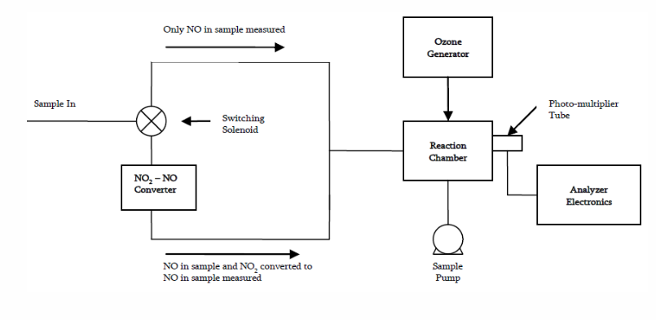
LAYOUT

Slide 17
flame ionization DETECTOR (FID)

Slide 18
WORKING
The flame ionization detector (FID) is a scientific instrument that measures analytes in a gas stream.
FID is the automotive emissions industry standard method of measuring hydrocarbon (HC) concentration He sample gas is introduced into a hydrogen flame inside the fid.
Any hydrocarbons in the sample will produce ions when they are burnt.
Ions are detected using a metal collector which is biased with a high DC voltage.
The current across this collector is thus proportional to the rate of ionization which in turn depends upon the concentration of HC in the sample gas.
The ionization process is very rapid, so the slow time response of conventional fids is mainly due to sample handling. A typical slow analyzer might have a response time of 1-2 seconds.
The combustion HFR fast response fid analyzers use conventional detection principles and a unique patented sampling system to give millisecond response times.

Slide 19
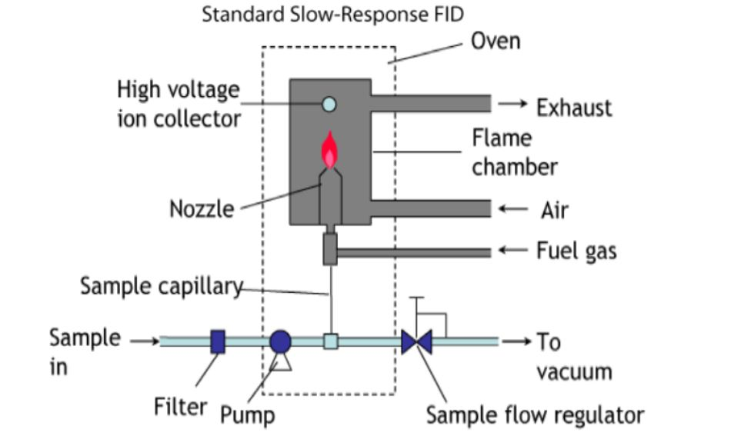
LAYOUT

Slide 20
GAS CHROMATOGRAPHIC PROCEDURE WITH flame ionization DETECTOR (GC FID)

Slide 21
WORKING
Gas chromatography – flame ionization detector or GC-FID is a very common analytical technique that is widely used for measuring methane
An FID typically uses a hydrogen/air flame into which the sample is passed to oxidize organic molecules and produces electrically charged particles (ions).
The ions are collected and produce an electrical signal which is then measured.
As common with other GC techniques, a carrier gas is required with low water and oxygen impurities since water and oxygen can interact with the stationary phase and cause significant problems such as high baseline noise and column bleed in the output gas chromatogram which both reduces the analyzer sensitivity and decreases column lifetime.
The FID is also extremely sensitive to hydrocarbon impurities in the hydrogen and air supply for the flame.
Hydrocarbon impurities can cause increased baseline noise and reduce the detector sensitivity.

Slide 22
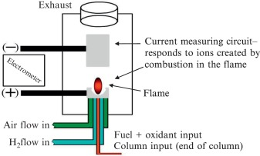
LAYOUT

Slide 23
GRAVIMETRIC SCALE

Slide 24
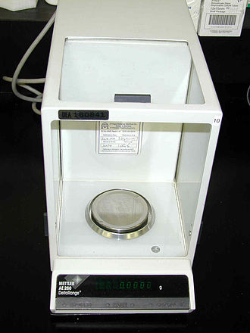
Gravimetric methods of sampling and analysis are commonly used to measure quantities of airborne particulate matter collected from workplace atmospheres.
Subsequent weighing of the total collected particulate matter plus filter yields the weight of the sampled aerosol by difference.
Weight of particulate matter collected on filters for emissions testing can be extremely low, therefore the weighing procedure has to be performed very accurately.
Analytical balance

Slide 25
PARAMAGNETIC O2 DETECTOR (PMD)

Slide 26
WORKING
Paramagnetic oxygen analyser measures the concentration of oxygen, employing a technique that is based on the fact that a magnet attracts gaseous oxygen.
In the cell, two glass spheres filled with nitrogen gas are suspended with strong metal wire.
When oxygen molecules having a large magnetic susceptibility flow there, the molecules are pulled toward the stronger magnetic field zone and the spheres are moved away from the zone.
The resulting deviation of the spheres is detected with the light receiving element.

Slide 27
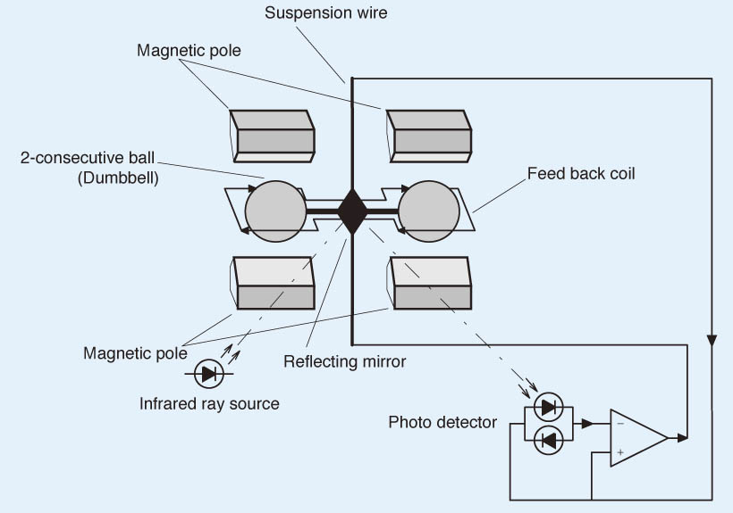
LAYOUT

Slide 28
MASS SPECTROMETER

Slide 29
WORKING
A mass spectrometer produces charged particles (ions) from the chemical substances that are to be analyzed.
The mass spectrometer then uses electric and magnetic fields to measure the mass ("weight") of the charged particles.
A mass spectrometer consists of three components: an ion source, a mass analyzer, and a detector.
The ionizer converts a portion of the sample into ions.

Slide 30
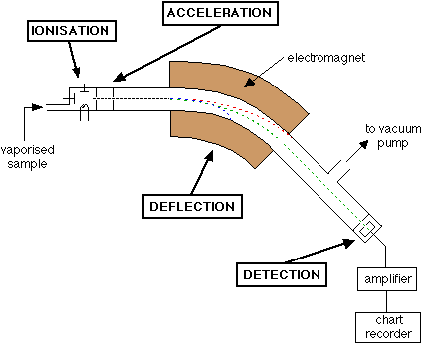
LAYOUT

Slide 31
Typical Mass Spectrum
Characterized by sharp, narrow peaks
X-axis position indicates the mass to charge ratio of a given ion (for singly charged ions this corresponds to the mass of the ion
Height of peak indicates the relative abundance of a given ion (not reliable for quantitation)
Peak intensity indicates the ion’s ability to desorb or “fly” (some fly better than others)

Slide 32
